Slide 1
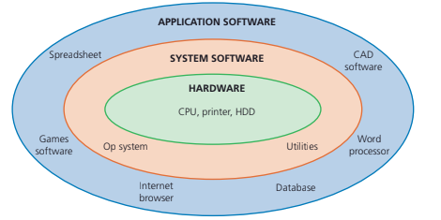
SOFTWARE
The programs running on the machine.
All computers begin life as a group of connected hardware items. Without software,
the hardware items would be useless.
The following figure shows the hierarchy of software and hardware

Slide 2
2 TYPES
APPLICATION SOFTWARE
Are for user benefit eg. word processors, internet browsers games etc
SYSTEM SOFTWARE
Are for operating and maintaining the hardware and to enable the application software to use the hardware efficiently.
eg. Operating System , utilities such as Backups, System scans etc, device drivers etc

Slide 3
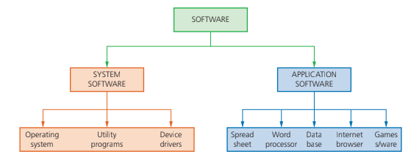

Slide 4
Features of system software
» set of programs to control and manage the operation of computer hardware
» provides a platform on which other software can run
» required to allow hardware and software to run without problems
» provides a human computer interface (HCI)
» controls the allocation and usage of hardware resources.

Slide 5
Features of application software
» used to perform various applications (apps) on a computer
» allows a user to perform specific tasks using the computer’s resources
» may be a single program (for example, NotePad) or a suite of programs (for example, Microsoft Office)
» user can execute the software as and when they require.

Slide 6
A word processor is software or a device that allows users to create, edit, and print documents. It enables you to write text, store it electronically, display it on a screen, modify it by entering commands and characters from the keyboard, and print it.
Of all computer applications, word processing is the most common. Today, most word processors are delivered either as a cloud service or as software that users can install on a PC or mobile device.
Some of the features they provide are formatting, copy , paste, spell checkers, thesaurus, importing photos, translation etc.
Examples - Microsoft word, Google Docs, LibreOffice Writer

Slide 7
A Spreadsheet is a table of values arranged in rows and columns. Each value can have a predefined relationship to the other values. If you change one value, therefore, you may need to change other values as well.
Spreadsheet applications (sometimes referred to simply as spreadsheets) are computer programs that let you create and manipulate spreadsheets electronically. In a spreadsheet application, each value sits in a cell. You can define what type of data is in each cell and how different cells depend on one another. The relationships between cells are called formulas, and the names of the cells are called labels
Examples - Microsoft Excel, Google Sheets, LibreOffice Calc etc

Slide 8
Database software
Used to store and manage data/databases, typically in a structured format.
Provides a graphical interface that allows users to create, edit and manage data fields and records in a tabular or organized form.
The data/database stored using this software can be retrieved in a raw or report based format
A database management system (DBMS) extracts information from the database in response to queries.
A DBMS further provides other features in order to maintain the data to enable fast updations as well as retrievals to users
Examples of DBMS - Oracle, MySQL Server, PostgreSQL

Slide 9
Photo Editing Software is used to alter images digitally, often to enhance their quality.
They have the ability to take scanned images of old film photography, convert them to digital images, and digitally restore them by removing blemishes and enhancing the contrast.
There are a number of other modifications available as well.
More advanced programs enable users to also perform operations such as background removal, healing, cloning, selective adjustments, and layering. These advanced programs often feature additional artistic functionalities like brush and pencil strokes, textures, and 3D design.
Examples - Adobe Photoshop, Adobe Lightroom, GIMP etc

Slide 10
Apps
Short for "application,"
Type of software that can be installed and run on a computer, tablet, smartphone or other electronic devices.
An app most frequently refers to a mobile application or a piece of software that is installed and used on a computer.
Most apps have a specific and narrow function.
Examples - Swiggy, WhatsApp, Gpay, Khan Academy Kids, Game Apps etc

Slide 11
Types of apps
Web-based app
An application that requires internet access for complete use.
Coded in JavaScript, HTML5 or CSS.
Requires a much smaller amount of memory space in a user's device because the databases are stored on the Internet server.
Examples of web-based apps include Netflix, Google Docs and Dropbox.

Slide 12
Native app
Apps that are created for a certain mobile platform are known as native applications.
For example, an app that is made for an Apple iPhone will only be usable on Apple devices and would not work on other types of mobile phones, such as Android.
Primarily used to provide the highest performance on a particular mobile operating system.
An example of a native app is the calculator application on the iPhone.

Slide 13
Hybrid app
An app that is made to support both native and web-based technologies
A combination of both web-based and native applications.
These apps are easier and quicker to create and only use a single code base that can be integrated across various platforms.
Hybrid apps often have a lower performance rate than native or web-based apps.

